Slide 1
Applied OSINT For Politics: Turning Open Data Into News
@lloydamiller
github.com/lloydamiller

Slide 2
What We Will Cover Today
How to investigate public figures
OSINT resources unique to public figures
Reporting discoveries for public good
Examples of how this works in the real world

Slide 3
The Political OSINT Process
Target
Package
Defend
Verify
Research
Release

Slide 4
How To Investigate Public Figures
What are you trying to accomplish and why
Avoid the spotlight
Dumpster diving is bad
Research before you search
Triage your time
Understand the law

Slide 5
OSINT Sources & Tools For Politics
Campaign Finance
Personal Financial Disclosure
Legislative Office Disbursements
Voter Records
Business Registrations
County Property Records
Public Records Requests

Slide 6
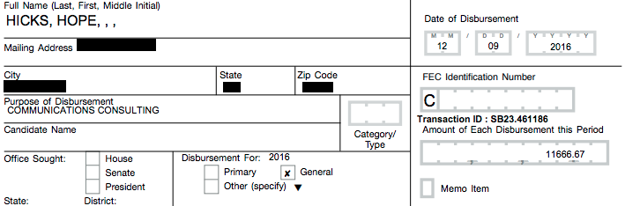
Campaign Finance OSINT
Donors (home addresses, employers)
Campaign Staff (home addresses, salaries)
Vendors
Consultants
Software
Office Space

Slide 7
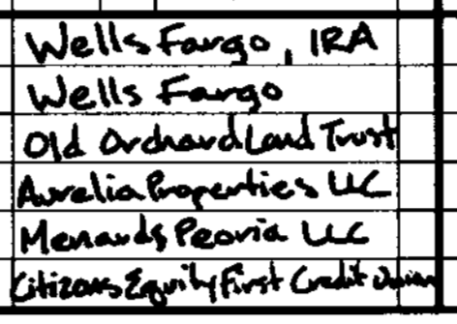
Financial Disclosure OSINT
Owned property
Business interests
Income sources
Mortgages, car loans
Bank, retirement, and investment accounts

Slide 8
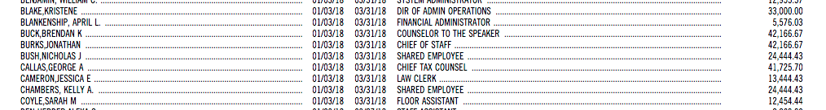
Legislative Office OSINT
Staff (names, titles, salaries)
Travel (and who paid for it)
Vendors and equipment

Slide 9
Voter Registration OSINT
Full Legal Name
Date of Birth
Social Security Number
Legal Residence
Partisanship

Slide 10
Order Of Attention
Reprehensible
Hypocritical
Immoral
Illegal
Unethical

Slide 11
What You Need To Consider When You Fleshing Out A Story
Why does this matter?
Has this happened before?
Who is your intended audience and why will they care?
Who knows more about this subject that you?
Are you willing to stake your reputation on this?

Slide 12
Ways To Release OSINT
Journalist
Local
National
Investigative
Partisan
Interested Party
Subject
Opponent
Outside Group
Self Publish

Slide 13
Pitching A Story
Know the reporter
Start small
Be prepared
Don’t over-promise
Be honest

Slide 14
Self-Publishing
Keep It Simple
Use Charts/Graphics
Be Cautious With Humor
Your existing audience ≠ your target audience
Promote And Pitch

Slide 15
OSINT In Action

Slide 16
Selling Out Before The Financial Crisis
What Happened: A member of the United States Congress was officially alerted of the impending financial crisis, and sold off significant stock holdings before those warnings were made public.
Tools:
News Reports
Financial Disclosure
Legislative Records

Slide 17

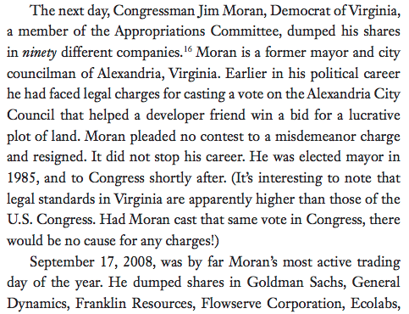
Selling Out Before The Financial Crisis

Slide 18
Family Money Laundering Campaign Contributions
What Happened: The family of a member of the United States Congress illegally loaned the member hundreds of thousands of dollars for his political campaign, violating campaign finance laws.
Tools:
Financial Disclosure
Campaign Finance Report

Slide 19
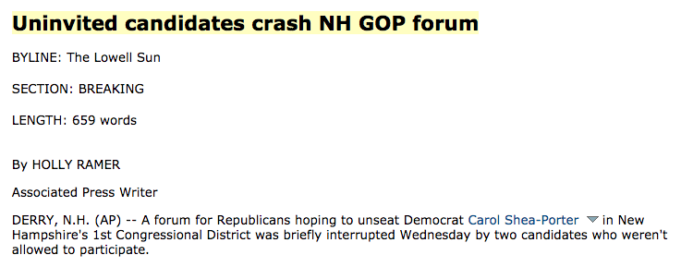
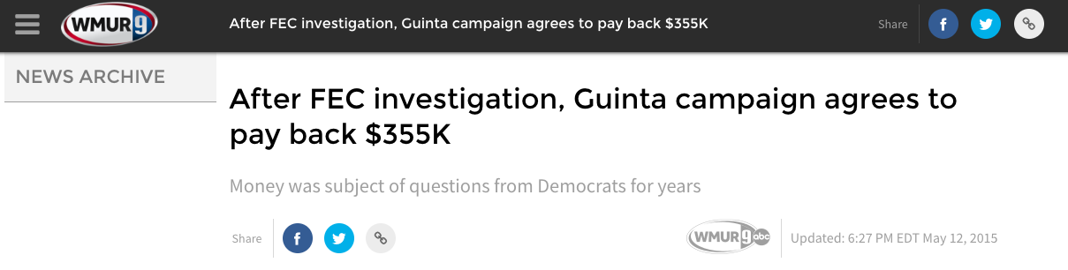
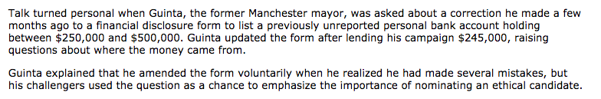
Family Money Laundering Campaign Contributions
August 2010
May 2015

Slide 20
How To Save $300,000 On A Home
What Happened: A U.S. Senator purchased a brand new home at a steep discount from a major campaign donor.
Tools:
Financial Disclosure
Campaign Finance Reports
County Registrar of Deeds
Campaign Finance Records

Slide 21



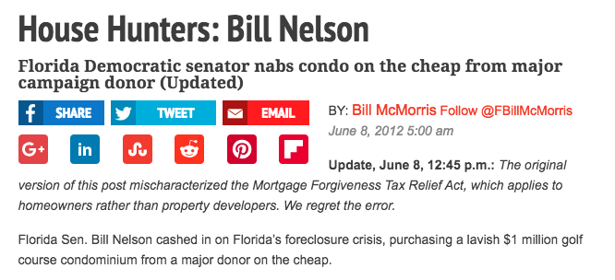
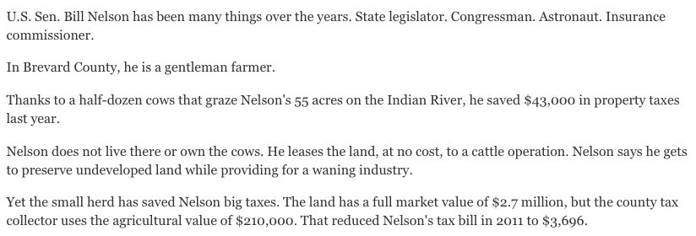
How To Save $300,000 On A Home

Slide 22
Downton Abbey On Capitol Hill
What Happened: A member of Congress fraudulently spent taxpayer and campaign money to enrich himself and support his lifestyle. And, like, a bunch of other bad stuff, too.
Tools:
Legislature Disbursements
Financial Disclosure
Campaign Finance Reports
Business Registration
Property Records

Slide 23
Downton Abbey On Capitol Hill

Slide 24

Downton Abbey On Capitol Hill

Slide 25
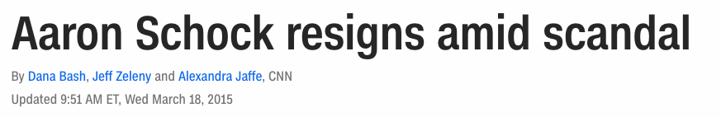
Downton Abbey On Capitol Hill

Slide 26
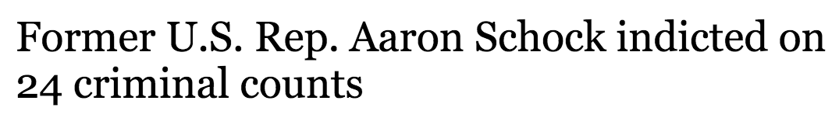
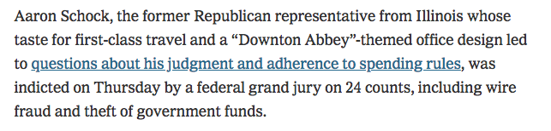
Downton Abbey On Capitol Hill

Slide 27
Voter Fraud Is Real
Types of voter fraud to find with OSINT
Duplicate Voting
False Registration
Ballot Petition Fraud
Tools:
Voter Registration Forms & Histories
Property Tax Records
Public Records Requests

Slide 28
Other OSINT Applied To Politics
Resume Exaggeration: stolen valor and resume inflation
Straw Donors: lower wage workers donating large sums to same politician as the company CEO
Plagiarism: matching unique phrases in writing authored by a public figure (speeches, too)
Planes And Yachts: tracking movements of the wealthy
Web Research: DNS records, google tracking codes, archived pages

Slide 29
Public Records Requests!
Don’t be afraid to ask a government entity for a document, they almost always MUST give it to you.
Be specific
Prepare to wait
If you hit a wall, ask for help
Public records requests are usually public records

Slide 30
Thank you.
Now go out there and find something.

